Slide 1
Clocks synchronization by network
Andrei Punko
by materials from Rod Stephens book
Notes:
The presentation dedicated to problem of clocks synchronization using network.
It was prepared by Andrei Punko using materials from Rod Stephens book

Slide 2
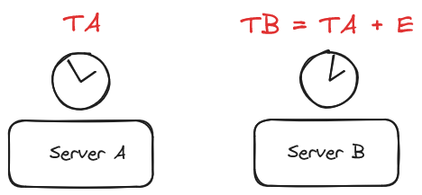
Notes:
Exact clock synchronization can be tricky due to inconsistent message transmission times that occur in a shared network. The problem becomes much easier if servers communicate directly without using a network. For example, if two computers are in the same room and you connect them with a wire, you can measure the wire’s length, calculate the time it takes for a signal to travel across the wire, and then use it to synchronize the computers’ clocks.
This works, but it is cumbersome and may not be possible between computers that are far apart. Fortunately, you can synchronize two servers' clocks fairly well by using a network if you assume that a network’s message transmission time doesn’t vary too much over a short period of time.
Suppose you want server B to synchronize its clock to the clock used by server A. Call the time according to server A the “true” time.
Suppose E is the error between the two clocks, so TB = TA + E at any given time.

Slide 3
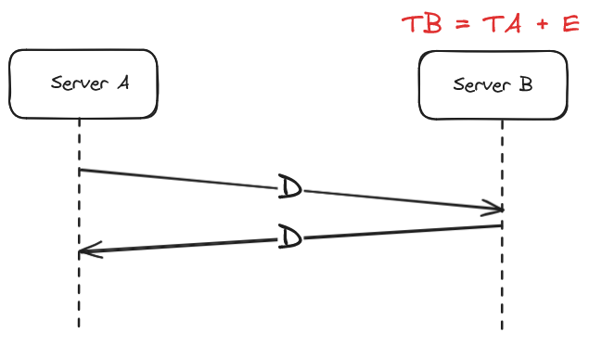
Notes:
Also suppose D is the delay required to send a message between the two servers.
Considered algorithm assumes that the delay remains roughly constant during the time it takes to pass the messages back and forth. It also assumes that a message from A to B takes about the same amount of time as a message from B to A.

Slide 4
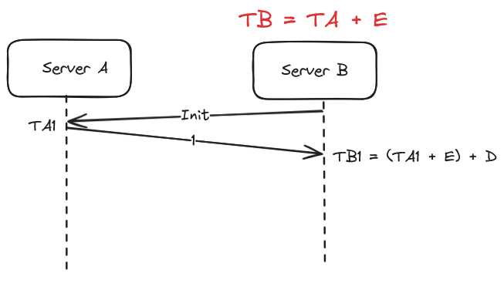
Notes:
The following steps describe the messages the servers should exchange:
0. Server B initiate communication by asking time of server A
1. Server A sends server B a message containing TA1 (the current time according to server A).

Slide 5
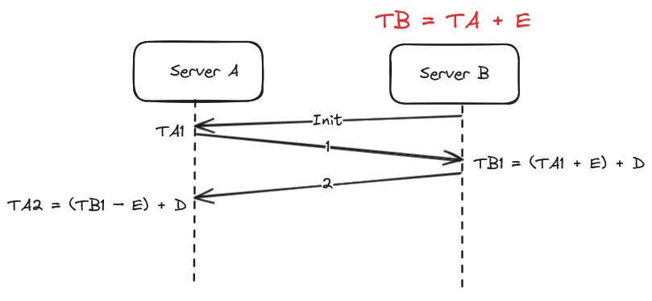
Notes:
2. Server B receives the message and sends server A a reply containing TA1 and TB1 (the current time according to server B).

Slide 6
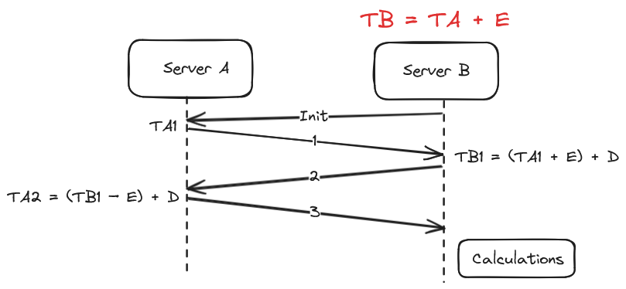
Notes:
3. Server A receives the reply and sends server B a new message containing TA1, TB1, and TA2 (the new current time according to server A).
Now server B can perform some calculations to synchronize its clock with server A.

Slide 7
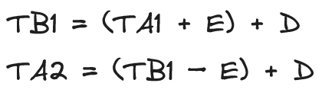
Notes:
As we said, suppose E is the error between the two clocks, so TB = TA + E at any given time. Also suppose D is the delay required to send a message between the two servers.
When server B records time TB1, the initial message took time D to get from server A to server B, so:
TB1 = (TA1 + E) + D
Similarly, when server A records time TA2, the reply took time D to get from server B to server A, so:
TA2 = (TB1 – E) + D

Slide 8
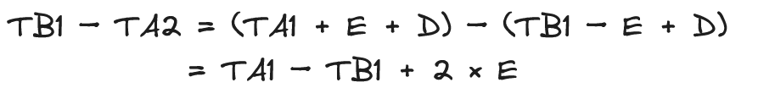
Notes:
If you subtract the second equation from the first, you get:
TB1 – TA2 = (TA1 + E + D) – (TB1 – E + D) = TA1 – TB1 + 2 × E

Slide 9
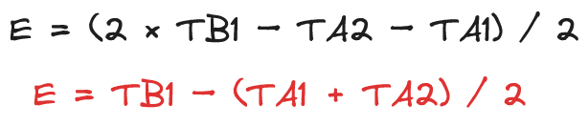
Notes:
Solving this equation for E gives:
E = (2 × TB1 – TA2 – TA1) / 2 = TB1 – (TA1 + TA2) / 2

Slide 10

Notes:
Now server B has an estimate of E, so it can adjust its clock accordingly.
This algorithm assumes that the delay remains roughly constant during the time it takes to pass the messages back and forth. It also assumes that a message from A to B takes about the same amount of time as a message from B to A.

